Slide 1
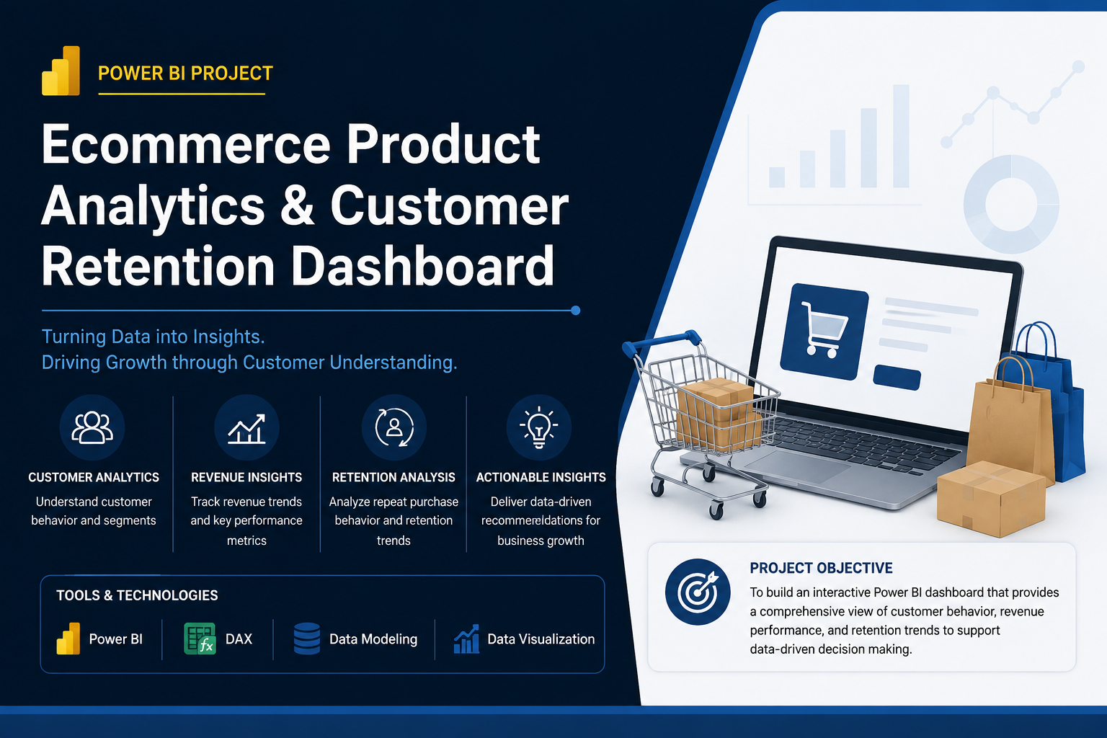

Slide 2
1.Introduction
“Good morning everyone.
Today I will present my project:
Ecommerce Product Analytics & Customer Retention Dashboard
This project was built using:
Power BI
DAX
relational data modeling
customer analytics techniques
The main objective of this project was to analyze:
customer behavior,
revenue trends,
retention performance,
and business KPIs
to support data-driven business decisions.”

Slide 3
2. Business Problem
“The ecommerce business lacked clear visibility into:
customer retention,
repeat purchase behavior,
payment trends,
and overall revenue performance.
Stakeholders wanted an interactive dashboard that could help identify:
high-value customers,
retention gaps,
and business growth opportunities.
To solve this problem, I built a multi-page Power BI dashboard focused on executive analytics, customer segmentation, and retention analysis.”

Slide 4
3. Dataset & Tools Used
“For this project, I used a relational ecommerce dataset containing:
customers,
orders,
payments,
products,
and transaction-level data.
I used:
Power BI for dashboard development,
DAX for KPI calculations,
and data modeling to create relationships between multiple tables.”

Slide 5
4. Executive Overview Dashboard
“On the first page, I created an Executive Overview Dashboard.
This dashboard provides a high-level business summary including:
total revenue,
total orders,
average order value,
revenue trends,
payment behavior,
and regional performance.
Some key insights identified were:
credit card payments contributed the highest revenue share,
São Paulo generated the strongest sales performance,
and revenue showed seasonal fluctuations across months.
Based on these findings, I recommended:
improving payment flexibility,
optimizing seasonal inventory planning,
and focusing retention campaigns in high-performing regions.”

Slide 6
5. Customer Segmentation Dashboard
“The second dashboard focuses on customer behavior analytics and segmentation.
I performed customer segmentation analysis to identify:
high-value customers,
loyal users,
and lower-value customer groups.
The treemap visual shows revenue contribution by customer segment, while the scatter plot analyzes customer order frequency versus revenue contribution.
One important insight was that a relatively small group of customers contributed a significant portion of overall revenue.
This highlighted the importance of:
retention-focused business strategies,
loyalty programs,
and personalized customer engagement.”

Slide 7
6. Cohort & Retention Analysis
“The third dashboard focuses on cohort and retention analysis.
I analyzed repeat purchase behavior over time using retention trends and cohort-style analysis.
The retention trend chart helped evaluate customer engagement patterns across different periods.
Key findings included:
relatively low repeat customer percentages,
varying retention across acquisition periods,
and strong impact of retention on long-term profitability.
Based on these findings, I recommended:
improving onboarding experience,
launching re-engagement campaigns,
and introducing loyalty incentives.”

Slide 8
7. Technical Skills Demonstrated
“Through this project, I demonstrated:
Power BI dashboard development,
DAX calculations,
data modeling,
KPI reporting,
customer segmentation,
cohort analysis,
retention analytics,
and business storytelling.
I also implemented:
interactive slicers,
dynamic filtering,
and multi-page dashboard reporting.”

Slide 9
8. Challenges Faced
“One challenge during the project was handling customer identifiers in the dataset.
The dataset contained both transactional customer IDs and unique customer identifiers.
To accurately calculate repeat customers and retention metrics, I used the unique customer identifier for customer-level analysis.”

Slide 10
9. Business Impact
“This dashboard helps stakeholders:
monitor business KPIs,
identify high-value customer groups,
track retention performance,
and improve customer lifecycle strategies.
The insights generated from this analysis can help improve:
customer retention,
profitability,
and long-term business growth.”

Slide 11
10. Conclusion
“To conclude, this project demonstrates how data analytics and business intelligence can help transform raw ecommerce data into actionable business insights.
By combining executive reporting, customer segmentation, and retention analysis, the dashboard provides a complete view of customer and business performance.
Thank you. I would be happy to answer any questions.”

